Slide 1
A CASE STUDY ANALYSIS BY ADEDOTUN LAWAL

Slide 2
CASE
This is a simplified subset of some data we have, one publisher (although multiple referring domains where traffic is sourced from) and one advertiser This data shows what happened to about 3,000 leads that were sold to the advertiser; their ultimate disposition is in Column E. Every row is a "lead."

Slide 3
Question 1.
Are we seeing any lead quality trends over time (improving, declining)? Are they statistically significant?

Slide 4
Assumptions and Definitions
Below are assumptions and definitions developed from the data set
Best lead quality are leads that closed.
Good lead quality is the combination of EP sent, EP received, and EP confirmed.
Bad lead quality is the combination of Unable to Contact, Contacted – Invalid Profile, and Contacted – Doesn’t qualify.
Unknown lead quality is null values in the data set.

Slide 5
Assumptions and Definitions
P-value indicates the probability of getting the same trend result.
A P-value greater than 0.05 indicates that the trend is not statistically significant.
A P-value lesser than 0.05 indicates that the trend is statistically significant.
Note: P-value is obtained using Tableau’s Trend line.

Slide 6
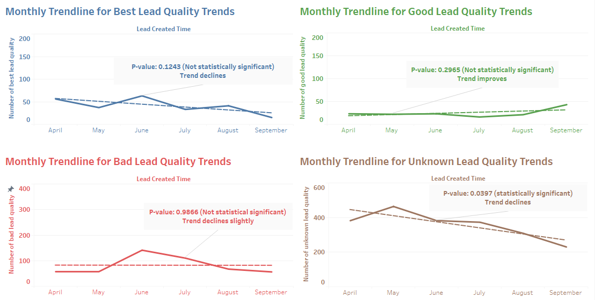
Answer to Question 1 (Chart 1)

Slide 7
Question 2.
What can we learn about the drivers of "lead quality" from this dataset?
What segments - where the ad was shown, what kind of person filled out the ad, what kind of ad did they see - have differing lead quality rates?

Slide 8
Assumptions and Definitions
All assumptions made in Question 1. hold here.
Publisher Zone Name refers to location on the page.

Slide 9
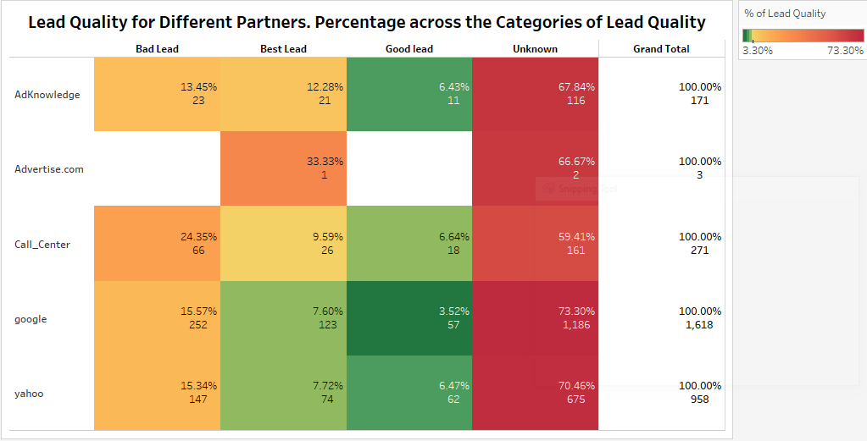
Answer to Question 2 (Chart 2)

Slide 10
Answer to Question 2 (chart 2) Cont’d (Some Discussions)
From Chart 2, it is evident that Yahoo and Google drove most of the ads driving to the site where test ads ran; the other partners did far less. Although, Adknowledge had the highest proportion of best lead quality, 12.28%, compared to Yahoo and Google, who had 7.72% and 7.60%, respectively. Call_Center also had a higher proportion of best lead quality compared to Yahoo and Google, but with a high proportion of bad lead, quality compared to any others.
No segment has differing lead quality rates. All the segments follow the same pattern of having Unknown lead quality have the highest percentage, and the other categories having about the same proportion. This can be seen from the charts below (chart 3 – chart 7).

Slide 11
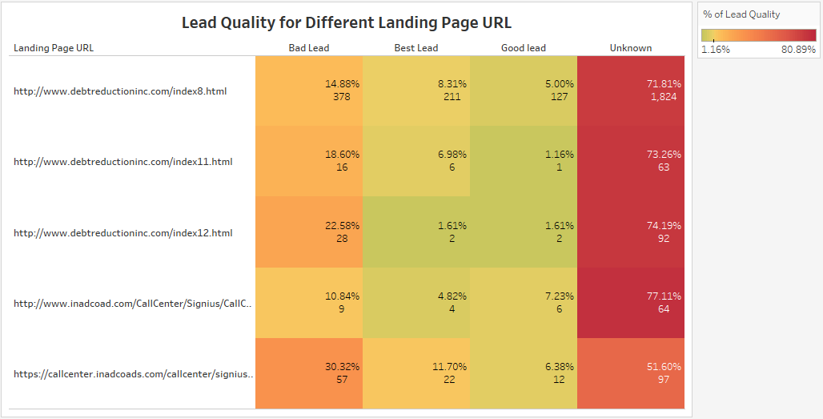
Answer to Question 2 (Chart 3)

Slide 12
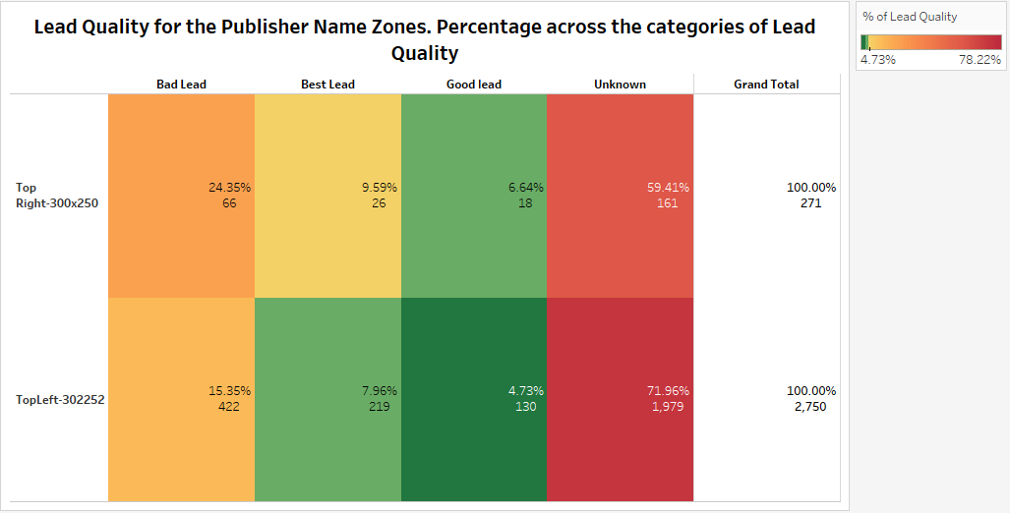
Answer to Question 2 (Chart 4)

Slide 13
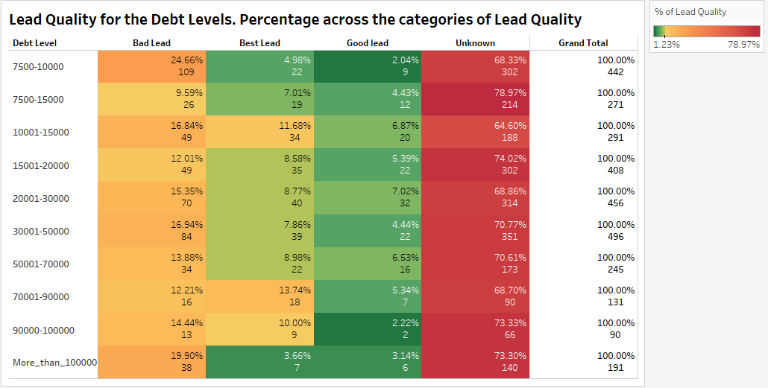
Answer to Question 2 (Chart 5)

Slide 14
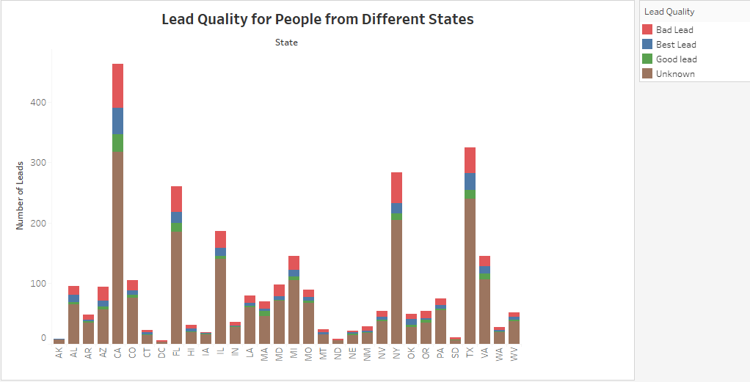
Answer to Question 2 (Chart 6)

Slide 15
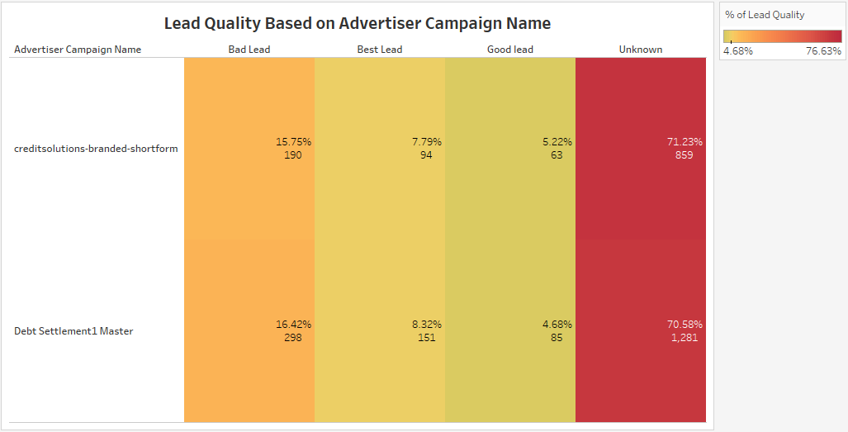
Answer to Question 2 (Chart 7)

Slide 16
Answer to Question 2
Chart 3 and Chart 4 are for “where the ad was shown”
Chart 5 and Chart 6 are for “what kind of person filled out the ad”
Chart 7 is for “what kind of ad did they see”
Chart 6 is a bar chart because it will be difficult to use the colored-rectangular chart because we have 32 states here. The chart won’t fit into a page.
We can see that chart 3 to chart 7 follow the same pattern for lead quality derived – the unknown lead quality has the highest percentage, and the others are close to each other.

Slide 17
Question 3.
If an advertiser says they will increase our CPL by 20% (i.e., $30 to $33) if we increase our lead quality by 20% (i.e., from 8.0% to 9.6%), do we see any opportunities to do that here? What kinds of things could we do?

Slide 18
Answer to Question 3
Yes, we see an opportunity to do that here.
One thing that could be done is using Adknowledge more than before. As seen from Question 2, Adknowledge gives the highest proportion of best lead quality.
Also, we can establish confidence in Adknowledge because its yield of best lead quality is consistent with its lead generation. This is seen in the plots on the next page. In the plots for Adknowledge, we see that when there is a decline in the number of leads generated, there is also a decline in the number of leads of best quality generated. This is evident from April to June. And when there is increase in the number of leads generated, there is an increase in the number of leads of best quality. This is evident from June to August. September is not considered, as the data set doesn’t show the yield of leads of best quality for this month. Moreover, the p-value for the best lead quality trend, which is declining

Slide 19
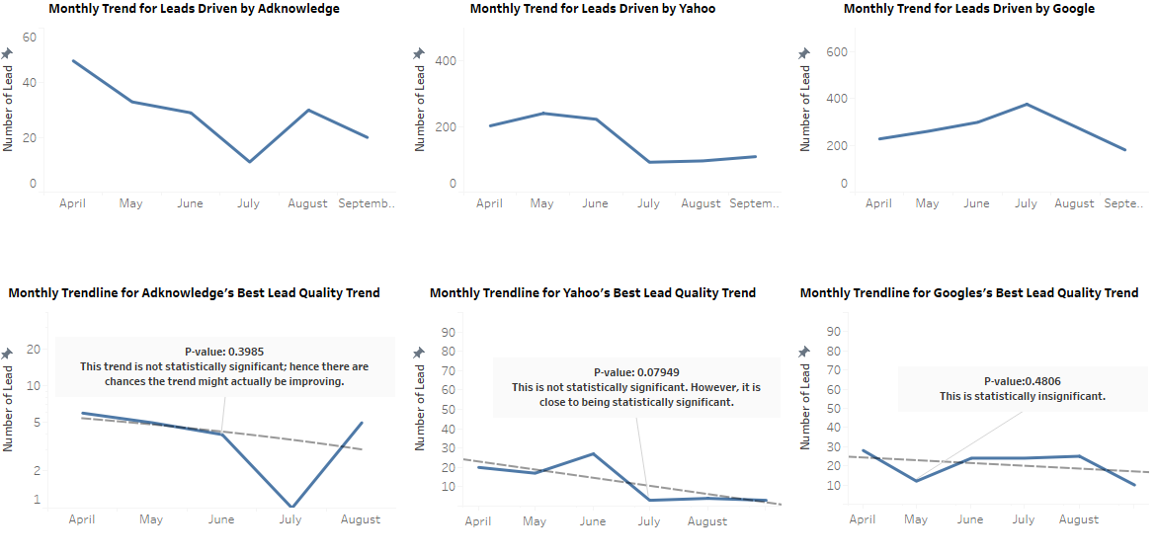
Answer to Question 3 (Chart 8)

Slide 20
Answer to Question 3 (Cont’d)
is not statistically significant; hence there are chances of the trend improving. Yahoo and Google also show the same behavior to some extent, like Adknowledge, in terms of consistency, but since Adknowledge has a high yield of lead of best quality, 12.28% compared to Yahoo and Google, we are sure an increase in lead generated by Adknowledge, will increase yield of lead of best quality. Thus we have a chance to increase lead quality for our advertisers.
•Another possible thing is to use the Top Right-300x250 location more. Reason can be seen in the next chart. Top Right-300x250 location gives a higher percentage of best lead quality than TopLeft-302250, 9.59% compared to 7.96%. Doing this also gives an opportunity of increasing lead quality for advertisers.

Slide 21
Answer to Question 3 (Chart 9)

